Slide 1
GAME ANALYSIS
Presented by: K.Nandini

Slide 2
Introduction of SQL
1
2
Game Analysis and Dataset
3
Questions of project
4
Explanation of project

Slide 3

SQL
SQL stands for the structured Query Language which is a poweful tool for managing and manipulating data in relational databases.It’s like a language your computer uses to talk to databases.
KEY CONCEPTS:
Database
Table
Query
Curd opration

Slide 4
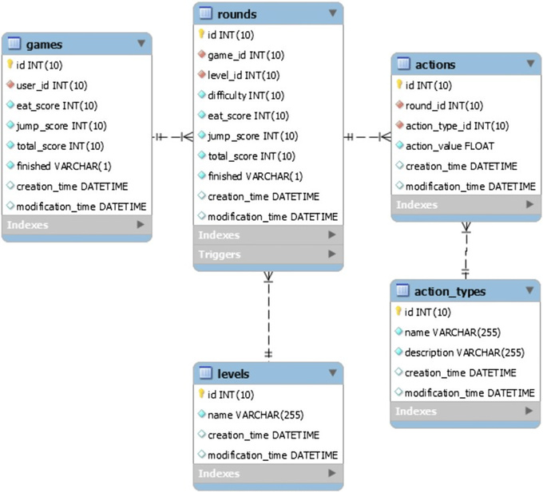
GAME ANALYSIS
Game analysis refers to the process of examining various aspects of
a game such as player behavior,
game mechanics,level design, and performances
metrics to gain insights into how the game is
played and how it can be improved.
The table shows the activity of player of some games.Each
rows isa record of a player
who logged in and played a number of games.

Slide 5
LET'S BEGIN!
Are you ready?

Slide 6
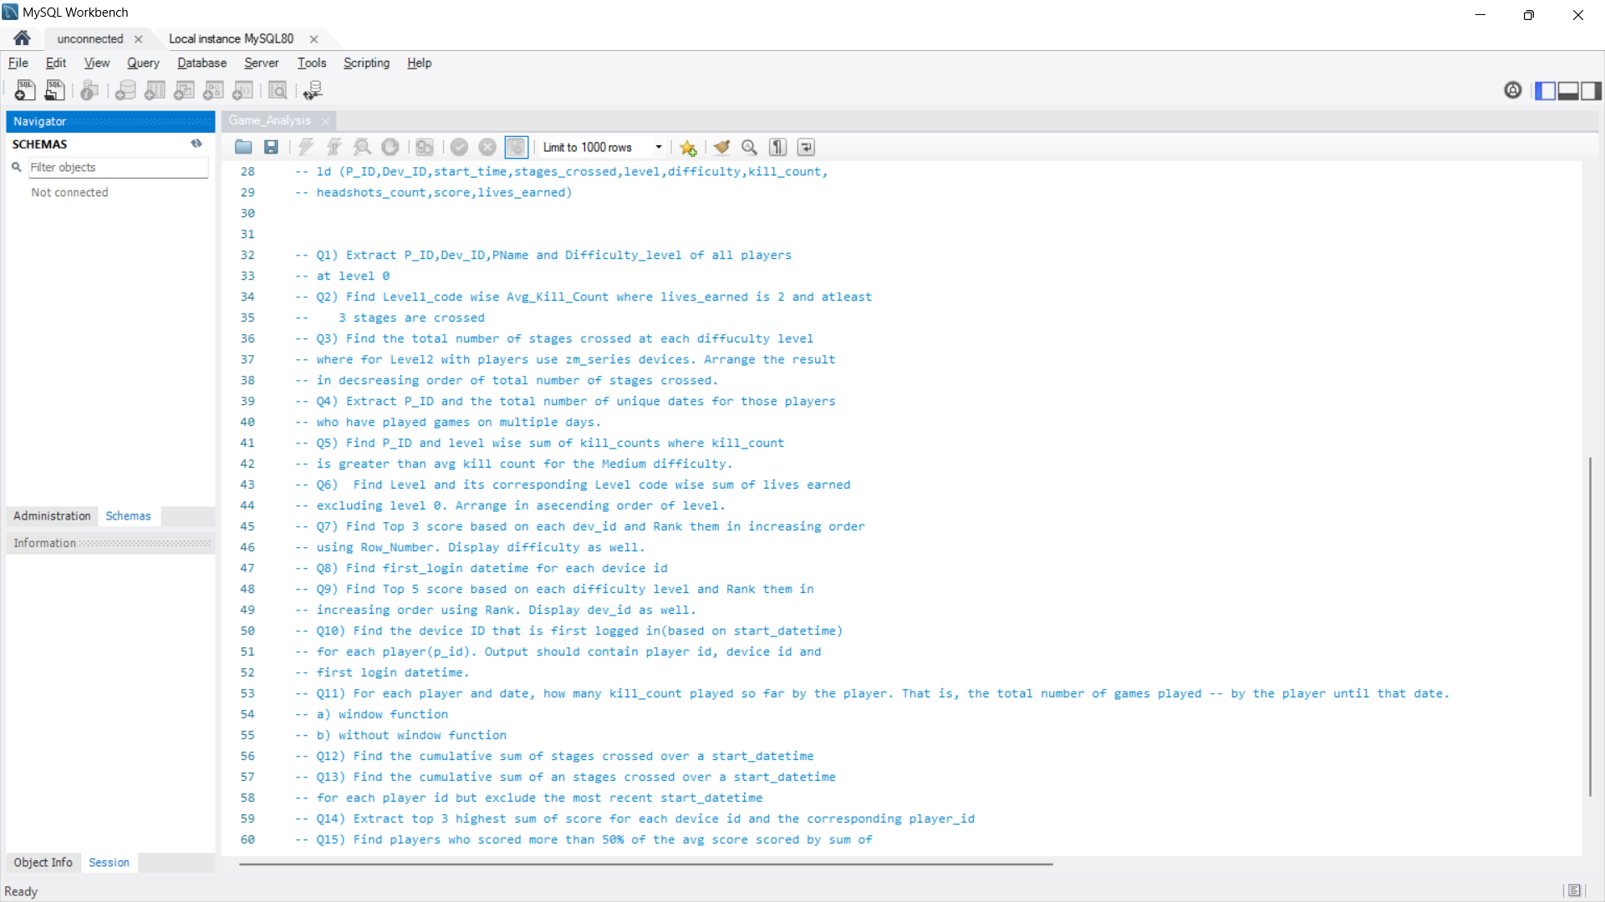
Below are the Questions for the task on game analysis of sql we will solve them which can be shown in next slides . We have the dataset which is based on the below questions and we need to solve th query by using the dataset

Slide 7
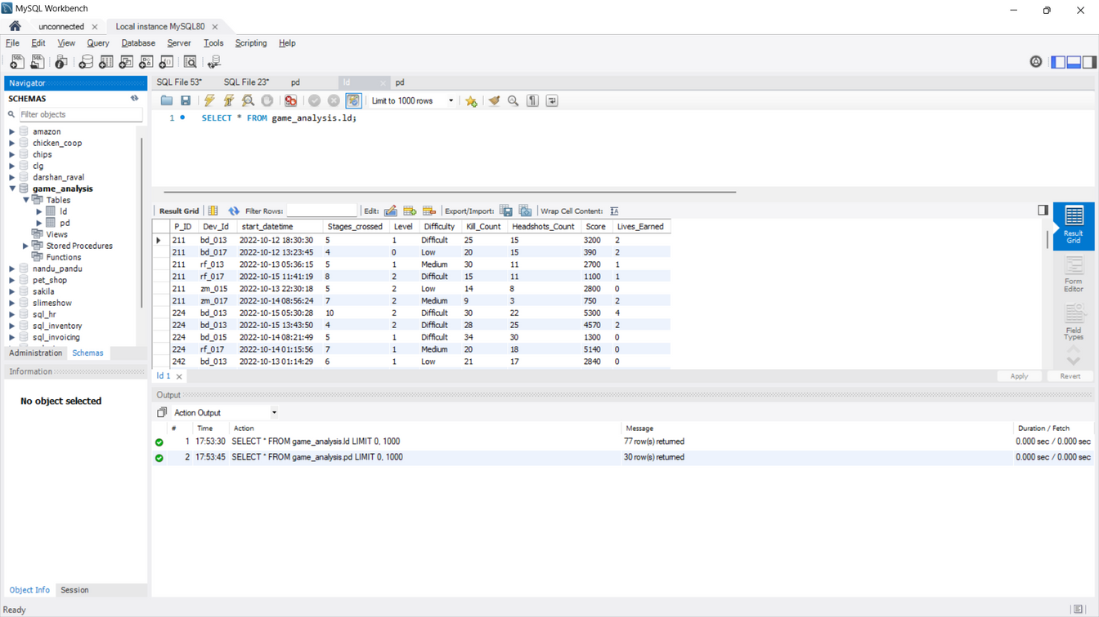
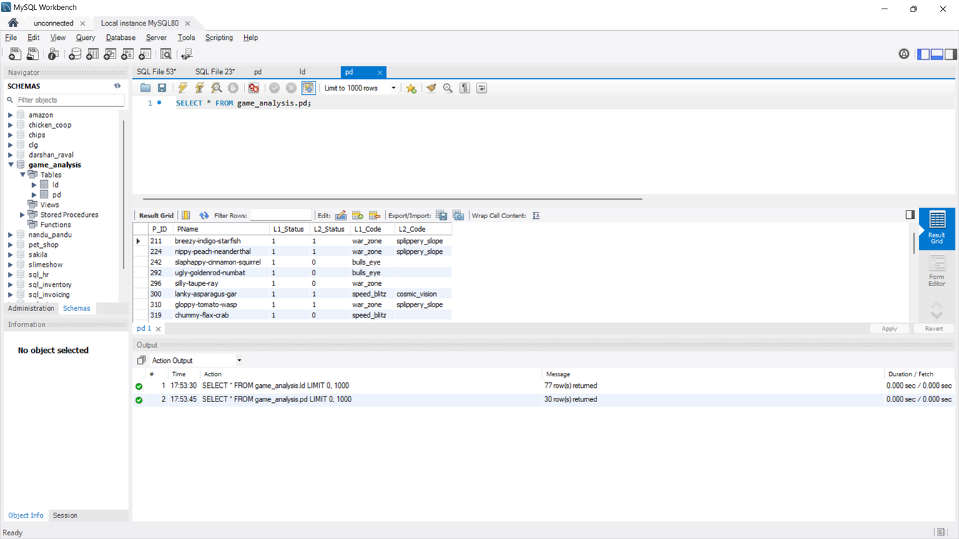
DATASETS
2
Identify criteria and rank attributes as high or low.
3
The tables that are presented in sql workbench

Slide 8
EXPLANATION ......
The solutions are presented in my sql workbench ,you can seen herewhich is represented according to my project questions have taken data from both tables to show the solution
I have taken 1 &2 questions First you have to enter the query according to question
select the enter query execute the query
by symbool which is highlightrd by RED CIRCLE
OR you can use longcut method which is CNTL+SHIFT+ENTER
The arrow present in the picture will show the execution of query i green color and even errors also represnted with red color which is easy to solve the questions
Next slide will show you the picture of execution

Slide 9
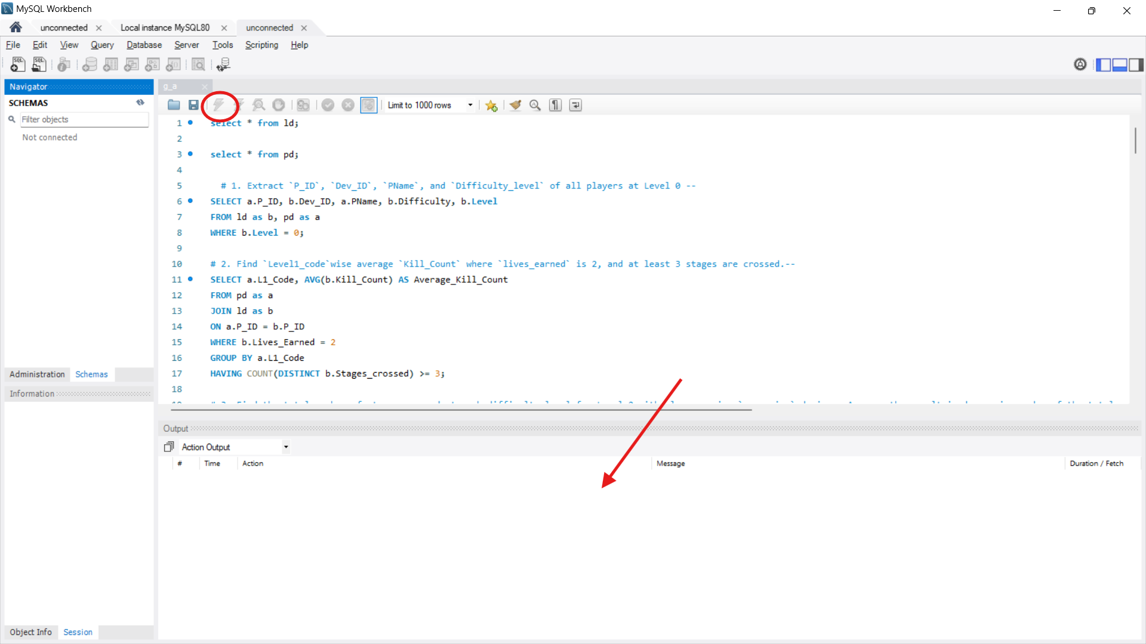
QUERY EXECUTION OF 1&2 QUESTIONS

Slide 10
THANK YOU!

